Slide 1
Chapter 1 1.5 Uncertainty in Measurement & Dimensional Analysis
Chemistry, The Central Science, 12th edition
Theodore L. Brown; H. Eugene LeMay, Jr.; and Bruce E. Bursten

Slide 2
Learning Goals:
By the end of class you will be able to…
Identify the uncertainty in measurements.
Convert units using dimensional analysis.

Slide 3
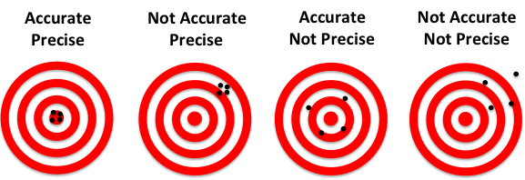
Uncertainty in Measurements
Different measuring devices have different uses and different degrees of accuracy/precision.

Slide 4
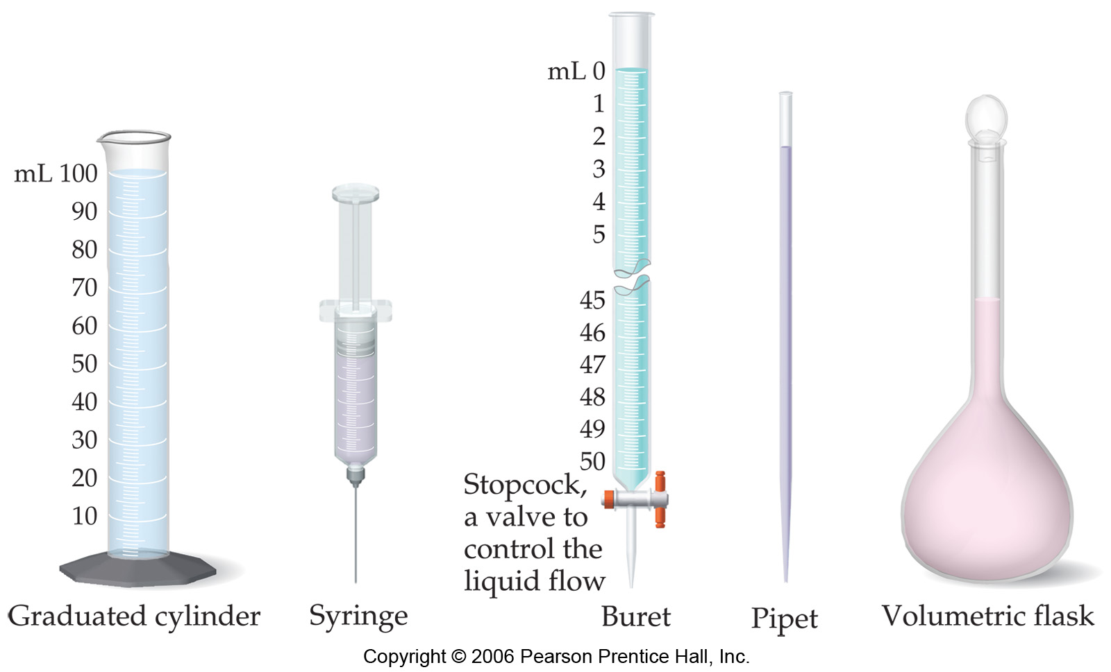
Uncertainty in Measurements
Which are more accurate?

Slide 5
Uncertainty in Measurements
Smaller
volumes
Larger volumes
It depends on amount…
Notes:
5

Slide 6
Exact versus inexact numbers
Exact Inexact
1000 g/kg ruler measure
2.54 cm/in Temp. reading
12/dozen volume or mass
any conversion etc.
factor

Slide 7
Significant Figures
The term significant figures refers to digits that were measured.
When rounding calculated numbers, we pay attention to significant figures so we do not overstate the precision of our answers.

Slide 8
Rules for Significant Figures
All nonzero digits are significant. (sig figs in red)
423.444
Zeroes between two significant figures are themselves significant.
42,300045 42,340.0025
Zeroes at the beginning of a number are never significant.
00042345.0 0.00048
Zeroes at the end of a number are significant if a decimal point is written in the number.
423,000 versus: 423,000.0 or: 423,000.000

Slide 9
Significant Figures
When addition or subtraction is performed, answers are rounded to the least significant decimal place.
24.245 (least significant)
+22.33488 (more significant)
46.57988 = 46.580 (least sig)
When multiplication or division is performed, answers are rounded to the number of digits that corresponds to the least number of significant figures in any of the numbers used in the calculation.
35.8750 (6 sig figs)
×40.006800 (8 sig figs)
1435.24395 = 1435.24 (6 sig figs)

Slide 10
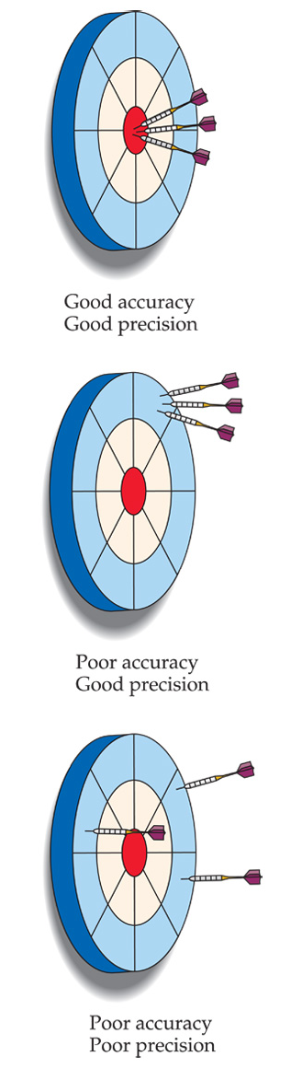
Accuracy versus Precision
Accuracy How close a measurement is to the true value. (How right you are)
Precision How close measurements are to each other. (Reproducibility). Precise but incorrect data are often the result of systematic errors.

Slide 11
1.6 Dimensional Analysis

Slide 12
Dimensional analysis
What do virtually all problems in chemistry have in common?
Answer: Dimensional analysis
Convert centimeters to feet: 1 cm = ? feet
Know: 2.54 cm = 1 in, 12 in = 1 foot.

Slide 13
Dimensional analysis

Slide 14
Dimensional Analysis
What do I need on top?
What do I need on the bottom?
What do I know? Conversion factors?
How do I get there?
Note: You will always be given the conversion factors you need, you don’t have to memorize them.
Note: You should always set everything up as a multiplication in fraction form

Slide 15
Dimensional analysis, examples
The speed of light is 2.998×10¹⁰ cm/s. What is it in km/hr?
Know: 1 km =1000m, 1m=100cm, 60 min =1 hr, 60 sec =1 min
What do I need on top? kilometers
What do I need on the bottom? hours

Slide 16
Dimensional analysis, examples
The Vehicle Assembly Building (VAB) at the Kennedy Space Center has a volume of: 3,666,500m³. What is it in liters?
Know: 1 L = 1 dm³, 1dm = 0.1 m
What do I need on top? Liters
What do I need on the bottom? nothing

Slide 17
Dimensional analysis, examples
An individual suffering from high cholesterol has 232 mg cholesterol per 100.0 mL of blood. How many grams of cholesterol in the blood, assuming a blood volume of 5.2 L?
Know: 1 L = 1000 mL, 1g = 1000mg
What do I need on top? grams
What do I need on the bottom? patient

Slide 18
Homework
Read pp. 20-30
Exercises #1.33, 1.35, 1.37, 1.39, 1.45, 1.51.
Sig Figs Handout
☺

